Slide 1



Smarter Care.
Faster Saves.
Coordinate transfers, manage equipment, and sync ICU beds across your city in one unified live network.

Slide 2


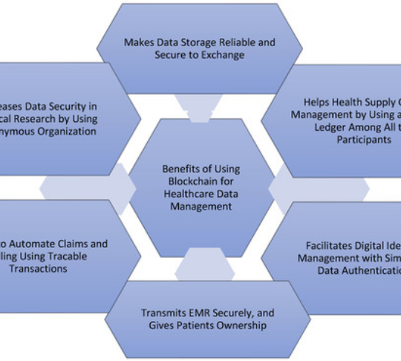


The Fragmented Crisis
Information Silos
Families visit 3-5 hospitals before finding a bed. Every minute increases mortality.
Manual Coordination
Coordination takes 30-90 mins. Resources remain hidden behind manual phone calls.

Slide 3






The MedGrid Ecosystem
Reception
Supervisor
Patient
Ambulance
Admin
Manage Bed Counts
Verify & Fraud Check
Find Real-time Care
Live Dispatch & GPS
Global Analytics

Slide 4
Unbreakable Architecture
Client Layer:
API Gateway:
Business Logic:
Data Persistence:

Slide 5







The Performance Stack
Engineered for sub-10ms response times under peak emergency load.

Slide 6






Inter-Network Mobility
Request
Filter
Notify
Accept
Reception triggers shortage alert
MedGrid identifies matching beds
Automated Twilio Call to receiver
One-click acknowledgement & GPS dispatch

Slide 7


Bilingual
AI Voice Agent
LLaMA 3.1 powered calls speaking Hindi & English. Real-time reasoning using live PostgreSQL data—not mock data.
"Indore mein Medanta Hospital mein 12 ICU bed khali hain. Call connect karne ke liye 1 dabaye."

Slide 8





MVP: The Indore Heartbeat
07
335
HOSPITALS
ICU UNITS
28
100%
DOCTORS
CITY COVERAGE

Slide 9
Sustainability & Scale
Stream | Model | Target Audience
SaaS Subscription | Tiered Monthly Fee | Private Multi-Specialty Hospitals
Govt Licensing | Annual City Contract | State Health Departments
Data Analytics | Premium API Access | Healthcare Research Institutions
Dispatch Fee | Per Trip commission | Private Ambulance Fleets

Slide 10



Let's Save Lives Together.
Ready for Pan-India Scalability.

Slide 11





Image Sources
https://static.vecteezy.com/system/resources/thumbnails/071/514/380/small_2x/3d-rendering-of-a-golden-and-silver-caduceus-a-symbol-of-medicine-and-healthcare-free-png.png
Source: www.vecteezy.com
https://www.mdpi.com/information/information-16-00106/article_deploy/html/images/information-16-00106-g001-550.jpg
Source: www.mdpi.com
https://static.vecteezy.com/system/resources/thumbnails/070/127/422/small/isometric-ambulance-render-against-transparent-space-a-beacon-of-assistance-and-quick-response-png.png
Source: www.vecteezy.com
https://st2.depositphotos.com/89930652/86319/i/450/depositphotos_863199852-stock-photo-green-gradient-sound-wave-pattern.jpg
Source: depositphotos.com
https://png.pngtree.com/png-clipart/20250119/original/pngtree-hospital-building-3d-illustration-png-image_20109507.png
Source: pngtree.com

